Slide 1


고객가치
새로운 시도
집요한 실행
Target-to-source mapping

Slide 2
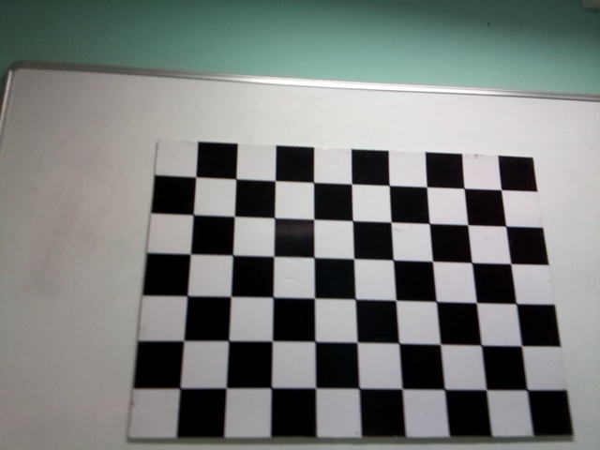
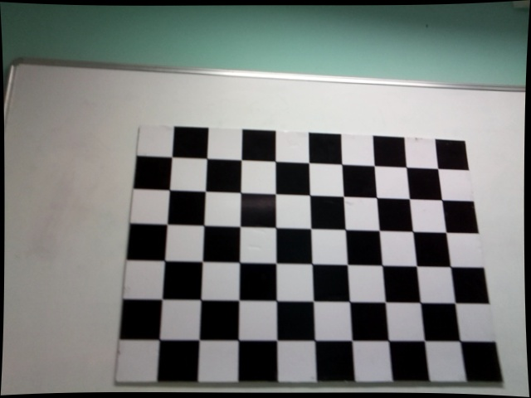
왜곡 보정 방법
이미지의 왜곡은 어떻게 펼까?
Distorted
Undistorted

Slide 3
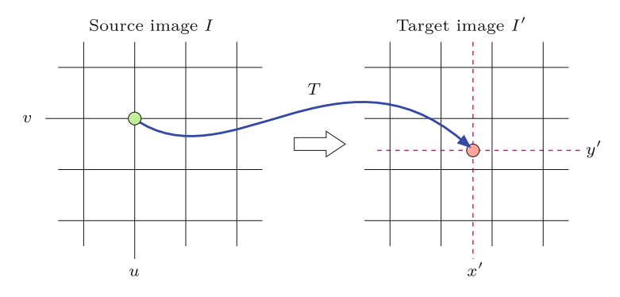
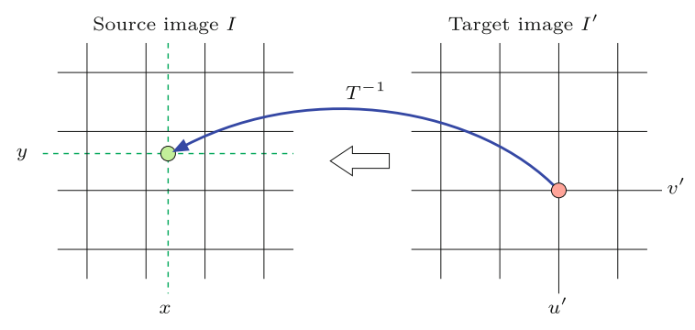




왜곡 보정 방법
❑ Source-to-target transformation
$$u^{′}=T\left(u\right)$$
❑ Target-to-source transformation
$$u=T^{−1}\left(u′\right)$$
source image $→$ distorted image
target image $→$ undistorted image

Slide 4
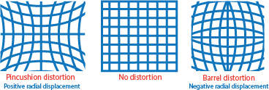
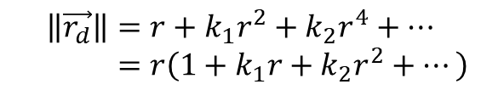




왜곡 보정 방법
Radial Distortion model: Assumes that the direction of the lens distortion is radial.
$$r^{2}=x^{2}+y^{2}$$
O
$$\left\|\vec{r_{d}}\right\|=r+k_{1}r^{2}+k_{2}r^{4}+… \\ =r\left(1+k_{1}r+k_{2}r^{2}+…\right)$$
$\vec{r_{d}}$: distorted point.
$\vec{r}$: undistorted point.
Distortion parameter: $k_{1},k_{2},k_{3},…$
To obtain the distortion parameters, we obtain $\left(x_{d},y_{d}\right)$ first.

Slide 5




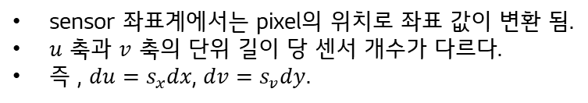



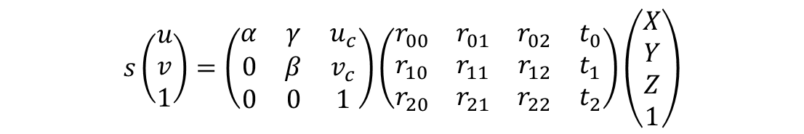












왜곡 보정 방법
$$\left(\frac{X}{Z},\frac{Y}{Z},1\right)≡\left(\frac{X}{Z},\frac{Y}{Z}\right)$$
a projected point
Sensor(pixel) coordinates
(거리를 pixel 단위로 환산)
$$\left(\frac{fX}{Z},\frac{fY}{Z},f\right)$$
$$P$$
$s_{u}$ pixels per unit length
$$u$$
$$\left(X,Y,Z\right)$$
$$\left(0,0\right)≡\left(u_{c},v_{c}\right)$$
$$x$$
$s_{v}$ pixels per unit length
Normalized image plane
$$o$$
$$1$$
$$f$$
camera center
$O$: the center of the camera
$f$: focal length of the camera
$$v$$
$$y$$
$$\left(x,y\right)≡\left(u,v\right)$$
$$y$$
$$x$$
sensor 좌표계에서는 pixel의 위치로 좌표 값이 변환 됨.
$u$ 축과 $v$ 축의 단위 길이 당 센서 개수가 다르다.
즉 , $du=s_{x}dx$, $dv=s_{v}dy$.
normalized
image plane
image plane
(사진으로 인쇄되는 평면)
(계산의 편의를 위해 정의한 평면)
$$s\left(\begin{aligned}u \\ v \\ 1\end{aligned}\right)=\left(\begin{matrix}α & γ & u_{c} \\ 0 & β & v_{c} \\ 0 & 0 & 1\end{matrix}\right)\left(\begin{matrix}r_{00} & r_{01} & r_{02} & t_{0} \\ r_{10} & r_{11} & r_{12} & t_{1} \\ r_{20} & r_{21} & r_{22} & t_{2}\end{matrix}\right)\left(\begin{aligned}X \\ Y \\ Z \\ 1\end{aligned}\right)$$
$f$: The focal length in pixel unit.
$γ$: skew coefficient. Usually, 0 for modern camera
$u_{c},v_{c}$: the coordinate of the principal point in pixel unit.
intrinsic parameters
extrinsic parameters

Slide 6
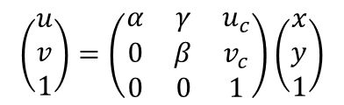

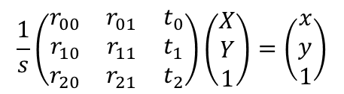


왜곡 보정 방법
According to the pinhole model, the projection of a 3D point to sensor coordinate can be written as:
$$s\left(\begin{aligned}u \\ v \\ 1\end{aligned}\right)=\left(\begin{matrix}α & γ & u_{c} \\ 0 & β & v_{c} \\ 0 & 0 & 1\end{matrix}\right)\left(\begin{matrix}r_{00} & r_{01} & r_{02} & t_{0} \\ r_{10} & r_{11} & r_{12} & t_{1} \\ r_{20} & r_{21} & r_{22} & t_{2}\end{matrix}\right)\left(\begin{aligned}X \\ Y \\ Z \\ 1\end{aligned}\right)$$
Let $Z=0$.
$$s\left(\begin{aligned}u \\ v \\ 1\end{aligned}\right)=\left(\begin{matrix}α & γ & u_{c} \\ 0 & β & v_{c} \\ 0 & 0 & 1\end{matrix}\right)\left(\begin{matrix}r_{00} & r_{01} & t_{0} \\ r_{10} & r_{11} & t_{1} \\ r_{20} & r_{21} & t_{2}\end{matrix}\right)\left(\begin{aligned}X \\ Y \\ 1\end{aligned}\right)$$
$$\left(\begin{aligned}u \\ v \\ 1\end{aligned}\right)=\left(\begin{matrix}α & γ & u_{c} \\ 0 & β & v_{c} \\ 0 & 0 & 1\end{matrix}\right)\frac{1}{s}\left(\begin{matrix}r_{00} & r_{01} & t_{0} \\ r_{10} & r_{11} & t_{1} \\ r_{20} & r_{21} & t_{2}\end{matrix}\right)\left(\begin{aligned}X \\ Y \\ 1\end{aligned}\right)$$
Since $s$ is the scale factor, we can say that the projection on the normalized image plane is equal to,
$$\frac{1}{s}\left(\begin{matrix}r_{00} & r_{01} & t_{0} \\ r_{10} & r_{11} & t_{1} \\ r_{20} & r_{21} & t_{2}\end{matrix}\right)\left(\begin{aligned}X \\ Y \\ 1\end{aligned}\right)=\left(\begin{aligned}x \\ y \\ 1\end{aligned}\right)$$
Thus, we can simply put as:
$$\left(\begin{aligned}u \\ v \\ 1\end{aligned}\right)=\left(\begin{matrix}α & γ & u_{c} \\ 0 & β & v_{c} \\ 0 & 0 & 1\end{matrix}\right)\left(\begin{aligned}x \\ y \\ 1\end{aligned}\right)$$
※ Note that $x$ and $y$ are the dimensionless parameters. The dimension of $α,β,γ,u_{c}$ and $v_{c}$ are [pixel].

Slide 7






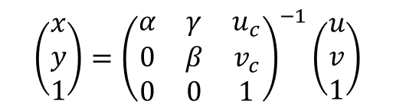
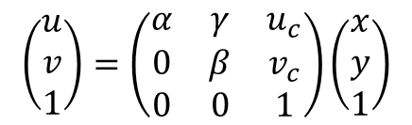
왜곡 보정 방법
Coordinate Transformation from sensor coordinate to normalized image coordinate.
$$y_{d}$$
Sensor coordinate
Cartesian coordinate
$$u$$
$$\left(0,0\right)$$
$$x_{d}$$
$$\left(7,0\right)$$
$$v$$
$$\left(\begin{aligned}u \\ v \\ 1\end{aligned}\right)=\left(\begin{matrix}α & γ & u_{c} \\ 0 & β & v_{c} \\ 0 & 0 & 1\end{matrix}\right)\left(\begin{aligned}x \\ y \\ 1\end{aligned}\right)$$
$$\left(\begin{aligned}x \\ y \\ 1\end{aligned}\right)={\left(\begin{matrix}α & γ & u_{c} \\ 0 & β & v_{c} \\ 0 & 0 & 1\end{matrix}\right)}^{−1}\left(\begin{aligned}u \\ v \\ 1\end{aligned}\right)$$
intrinsic parameters
$\left(x,y\right)$ is the coordinate in the normalized image plane.

Slide 8




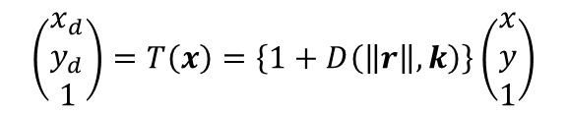

왜곡 보정 방법
Source image = distorted image
Target image = undistorted image
$$y_{d}$$
$$y$$
?
$$x_{d}$$
$$x$$
Unknown
Inverse transformation
$$\left(\begin{aligned}x_{d} \\ y_{d} \\ 1\end{aligned}\right)=T\left(x\right)=\left\{1+D\left(\left\|r\right\|,k\right)\right\}\left(\begin{aligned}x \\ y \\ 1\end{aligned}\right)$$
where $D\left(\left\|r\right\|,k\right)=k_{1}r^{2}+k_{2}r^{4}+…$
Usually, $\left(x_{d},y_{d}\right)$ does not locate at the grid point. $→$ Interpolation is inevitable.

Slide 9

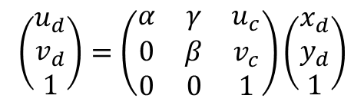


왜곡 보정 방법
Source image = distorted image
Target image = undistorted image
Get interpolated pixel value
?
$$x_{d}$$
$$x$$
Unknown
$$y$$
$$y_{d}$$
Target_image$\left[u,v\right]$ = Source_image$\left[u_{d},v_{d}\right]$
$$\left(\begin{aligned}u_{d} \\ v_{d} \\ 1\end{aligned}\right)=\left(\begin{matrix}α & γ & u_{c} \\ 0 & β & v_{c} \\ 0 & 0 & 1\end{matrix}\right)\left(\begin{aligned}x_{d} \\ y_{d} \\ 1\end{aligned}\right)$$

Slide 10
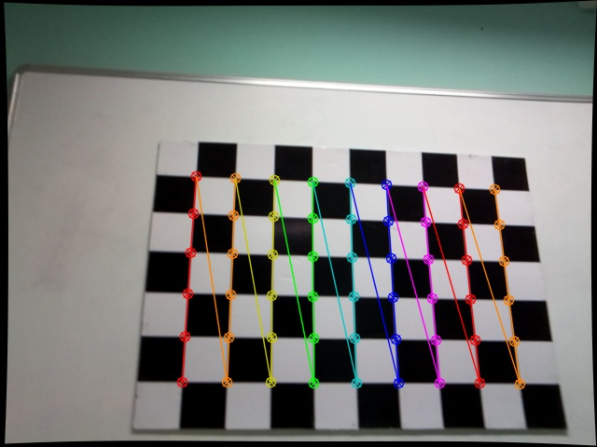
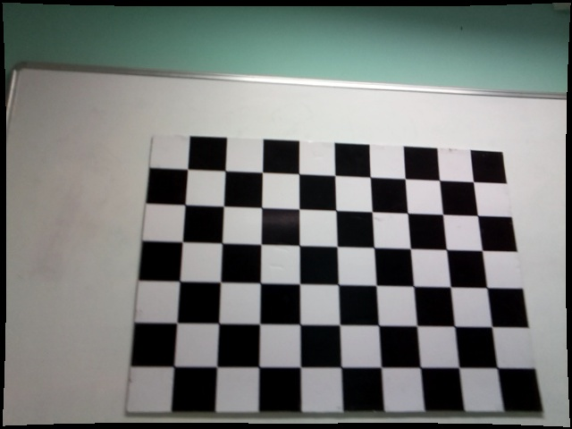
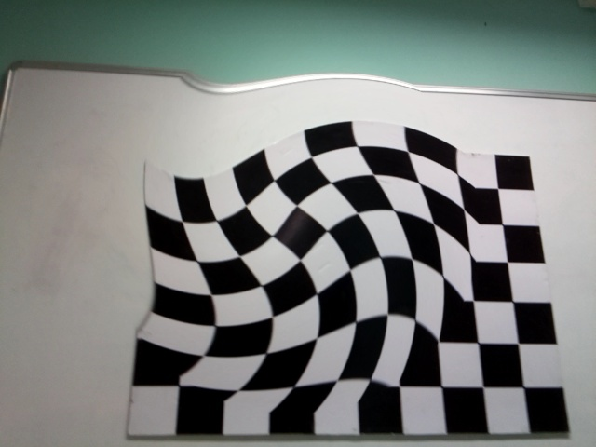
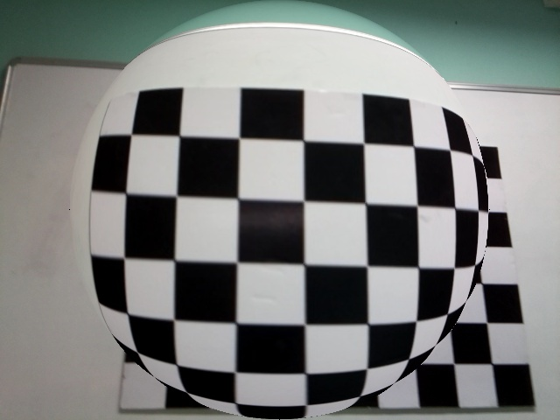
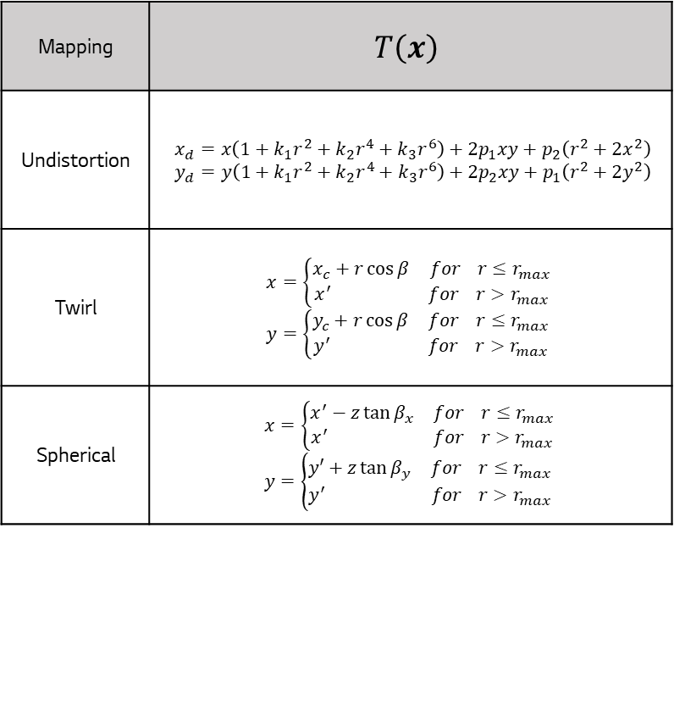
왜곡 보정 방법
Mapping | $$T\left(x\right)$$
Undistortion | $$x_{d}=x\left(1+k_{1}r^{2}+k_{2}r^{4}+k_{3}r^{6}\right)+2p_{1}xy+p_{2}\left(r^{2}+2x^{2}\right) \\ y_{d}=y\left(1+k_{1}r^{2}+k_{2}r^{4}+k_{3}r^{6}\right)+2p_{2}xy+p_{1}\left(r^{2}+2y^{2}\right)$$
Twirl | $$x=\left\{\begin{aligned}x_{c}+r\cos{β} for r≤r_{max} \\ x^{′} for r>r_{max}\end{aligned}\right. \\ y=\left\{\begin{aligned}y_{c}+r\cos{β} for r≤r_{max} \\ y^{′} for r>r_{max}\end{aligned}\right.$$
Spherical | $$x=\left\{\begin{aligned}x^{′}−z\tan{β_{x}} for r≤r_{max} \\ x^{′} for r>r_{max}\end{aligned}\right. \\ y=\left\{\begin{aligned}y′+z\tan{β_{y}} for r≤r_{max} \\ y^{′} for r>r_{max}\end{aligned}\right.$$
Distorted (Raw)
Undistorted (OpenCV)
Undistorted (Homemade)
Twirl (Homemade)
Spherical (Homemade)

